Slide 1
Chapter 2
Finite Automata

Slide 2
Proof Example #3
S is the set of words accepted by
T is the set of words that has no consecutive 1’s
To say that S = T we must proof that :
If w is in S then w is in T
If w is in T the w is in S
0
0,1
start
a
1
b
1
c
0

Slide 3
Proof Example #3
If w is in S then w is in T
If δ (a, w ) = a then w has no consecutive 1’s and des not end with 1
If δ (a, w ) = b then w has no consecutive 1’s and ends with a single 1
0
0,1
start
a
1
b
1
c
0

Slide 4
Example #4
Build a DFA for the following language: L = { w | w is a bit string which contains the substring 11}

Slide 5
DFA for strings containing the substring 11
0,1
0
0
start
q₀
q₁
q₂
1
1
start state means the most recent input was not a 1
has never seen 11 but the most recent input was a 1
has seen 11 at least once.

Slide 6
DFA for strings containing 11
Q = {q₀,q₁,q₂}
∑ = {0,1}
start state = q₀
F = {q₂}
Transition table for the DFA, A = {Q, ∑ , q₀,F, δ }
symbols
A transition function δ(q_{0,} 0) =q₀
0
1
q₀
q₀
q₁
states
q₁
q₀
q₂
*q₂
q₂
q₂

Slide 7
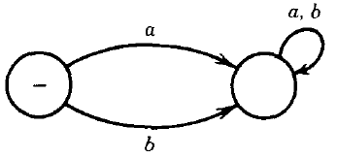
FA Notes
There are FA's that accept no language in two kinds:
FA's that have no final states, such as
dead state

Slide 8
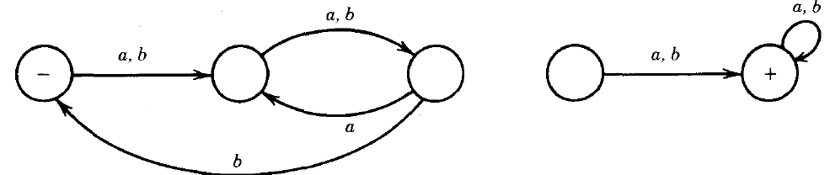
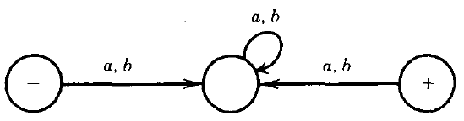
FA Notes (Con.)
2. FA's in which the circles that represent the final states cannot be reached from the start state. (i.e., graph is disconnected)

Slide 9
A language over the alphabet Σ ={a, b} accepts the set of string that has at least a or b.
Example #5
a
a,b
-
x
Start
b

Slide 10
Draw the FA that accept all words over the alphabet Σ ={a, b}, including the word ∊ ( ^ )
Example #6
a,b
-

Slide 11
Example #7
Build a machine (i.e., finite automaton) that accepts all the words with an even number of letters over the alphabet Σ ={a, b} .
a , b
-
a , b

Slide 12
Example #8
Build a machine (i.e., finite automaton) that accepts all the words starts with a over the alphabet Σ ={a, b}
a, b
dead state
q₁
b
start
q₀
a,b
a
q₂

Slide 13
Example #8 cont.
a, b
dead state
q₁
b
start
q₀
a,b
a
q₂
q₃
a,b

Slide 14
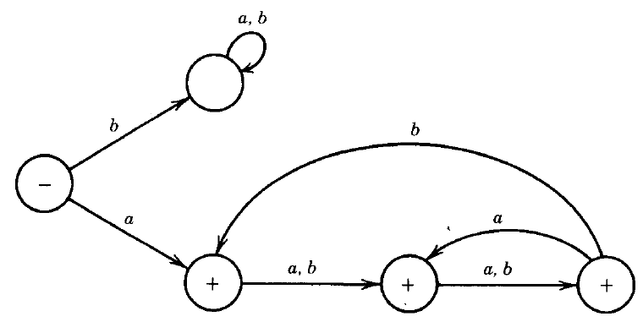
Example #8 cont.
dead state

Slide 15
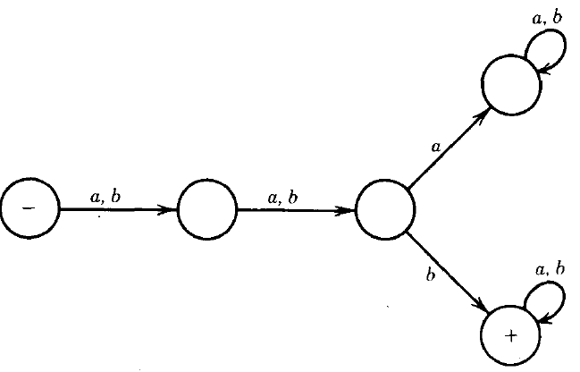
Example #9
Build a FA for a language over the alphabet Σ ={a, b} accepts strings that starts with a or b and the third letter is b:
dead state

Slide 16
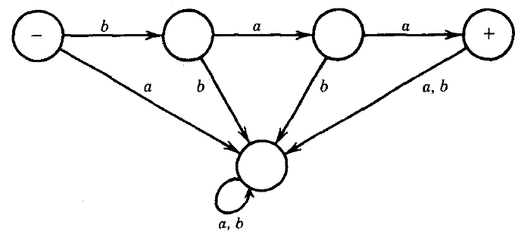
Example #10
Let us consider a very specialized FA, one that over the alphabet Σ ={a, b} and accepts only the word baa?
dead state

Slide 17
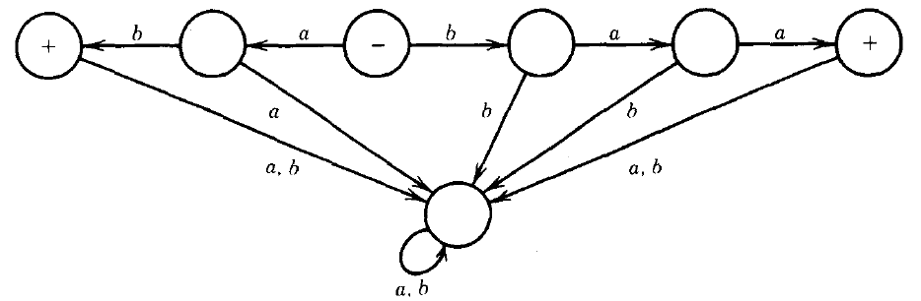
Example #11
Build a FA that accepts exactly the two strings baa or ab.
dead state

Slide 18
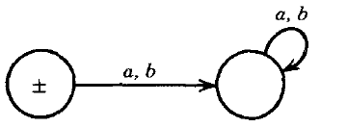
Example #12
The following FA accepts only the word ∊
dead state

Slide 19
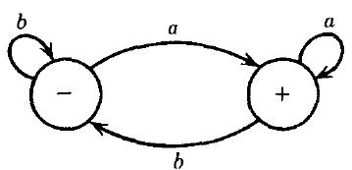
Example #13
Build a FA for the strings over the alphabet Σ ={a, b} and ends with a

Slide 20
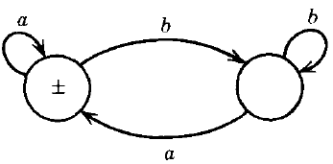
Example #14
Build a FA for the language over the alphabet Σ ={a, b} and accepts all words that do not end in b.

Slide 21
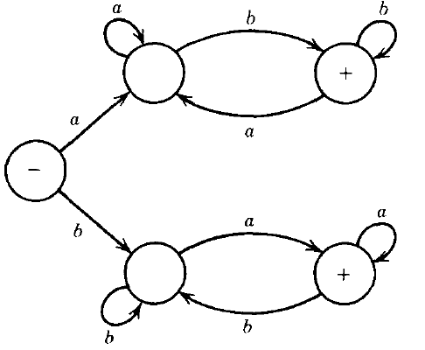
Example #15
Build a FA accepts all words that have different first and last letters. If the word begins with an a, to be accepted it must end with a b and vice versa.
Prove the following
string aabbaab in the FA?

Slide 22
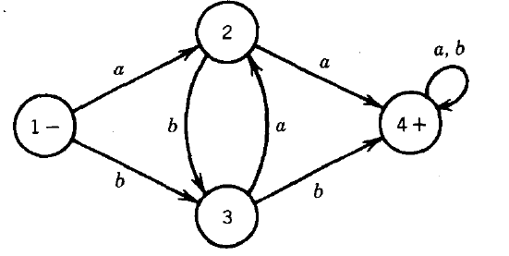
Example #16
Build a FA for a language over the alphabet Σ ={a, b} accepts strings that contains either aa or bb

Slide 23
Example #17
Build a finite automaton over the alphabet Σ ={a, b} and accepts all words containing a triple letter, either aaa or bbb, and only these words.
a
a
a
a, b
a
b
+
-
b
b
b
b
a

Slide 24
Example #18
Build a DFA for the following language: L = { w | w is a binary string that has even number of 1s and even number of 0s}
?

Slide 25
Example #19
Build a DFA for the following language: L = { w | w is a string over a , and b starts ( aa or bb ) and ends with ( aa or bb )

Slide 26
Example #19 cont.
b
a
b
b
+
a
a
b
b
-
a, b
a
b
a
b
b
a
a
+
b
a
a

Slide 27
Exercises
The set of all strings whose tenth symbol from the left end is a 1.
The set of strings that either begin or end (or both) with 01

Slide 30
Exercises
Let = Σ ={0, 1} , Give DFA's accepting The set of all binary string , which are divisible by 3.
Let = Σ ={0, 1} , Give DFA's accepting The set of all binary string , which are divisible by 5.
Let = Σ ={0, 1} , Give DFA's accepting The set of all binary strings start with 1 , and divisible by 5.

